Slide 1
SE 441: Software Engineering Professional Ethics
Md. Fahad Bin Zamal

Slide 2
Software Engineering Code of Ethics
27
Notes:
Based on slides prepared by: John Eveland
John Hoffstatter

Slide 3
What is code of ethics?
A set of moral principles or values
Governs an individual or a group
Deals with what is good and bad with moral duty and obligation

Slide 4
History
IEEE Board of Governors established steering committee (May, 1993).
ACM Council endorsed Commission on Software Engineering (Late 1993).
Joint steering committee established by both societies (January, 1994).

Slide 5
Brief History Timeline
January 1994 - International Task Force formed the Software Engineering Ethics and Professional Practice (SEEPP).
July 1997 - Initial version shown to professional societies including ACM’s SIGSOFT.
November 1997 - Version 3 published in IEEE-CS and ACM magazines.
Version 4 presented to IEEE review process.
October 1998 - Version 5.2 unanimously adopted by ACM and IEEE.

Slide 6
8 Key Principles:
Public
Client and Employer
Product
Judgment
Management
Profession
Colleagues
Self

Slide 7
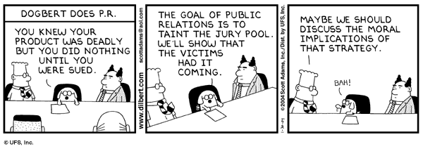
Public
Disclose to appropriate persons or authorities any actual or potential danger to the user, the public, or the environment, that they reasonably believe to be associated with software or related documents.

Slide 8
Public
1.01
1.02
1.03
1.04
1.05
1.06
1.07
1.08
Accept responsibility for your own work
Approve only safe, well tested software Only sign documents in area of competence Cooperate on matters of public concern Produce software that respects diversity
Be fair and truthful in all matters Always put the public’s interests first Donate professional skills to good causes

Slide 9
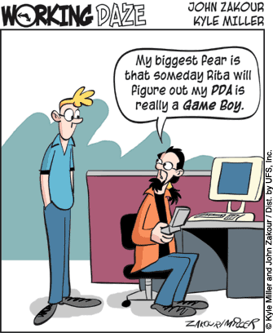
Client & Employer
Promote no interest adverse to their employer or client, unless a higher ethical concern is being compromised; in that case, inform the employer or another appropriate authority of the ethical concern.

Slide 10
Principle 2: Client and Employer
2.01
2.02
2.03
2.04
2.05
2.06
2.07
2.08
2.09
Provide services only where competent Ensure resources are authentically approved Only use property as authorized by the owner Do not use illegally obtained software
Honor confidentiality of information Raise matters of social concern
Inform when a project becomes problematic Accept no detrimental outside work
Represent no interests adverse to your employer

Slide 11
Principle 3:Products
3.01
3.02
3.03
3.04
3.05
3.06
3.07
3.08
3.09
Ensure adequate software specification Understand specifications fully
Ensure you are suitably qualified Ensure all goals are achievable Ensure proper methodology use Ensure good project management Ensure all estimates are realistic Ensure adequate documentation
Ensure adequate testing and debugging

Slide 12
Principle 3: Products(Cont.)
3.10
3.11
3.12
3.13
3.14
cost
3.15
Promote privacy of individuals Use data legitimately
Delete outdated and flawed data Identify and address contentious issues
Promote maximum quality and minimum
Follow appropriate industry standards

Slide 13
Principle 4: Judgment
4.01
4.02
4.03
4.04
4.05
4.06
4.07
4.08
Maintain professional objectivity
Only sign documents within your responsibility Reject bribery
Do not accept secret payments from the client Accept payment from only one source for a job Disclose conflicts of interest
Avoid conflicting financial interests Temper technology judgments with ethics

Slide 14
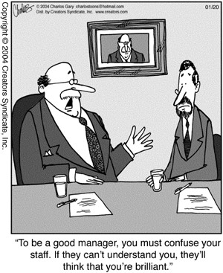
Management
Ensure good management for any project on which they work, including effective procedures for promotion of quality and reduction of risk.

Slide 15
Principle 5: Management
5.01
5.02
5.03
5.04
5.05
5.06
5.07
5.08
5.09
Assure standards are known by employees Assure knowledge of confidentiality protocols Assign work according to competence Provide due process for code violations Develop fair ownership agreements
Accurately describe conditions of employment Offer only fair and just remuneration
Do not prevent a subordinate’s promotion Do not ask a person to breach this code

Slide 16
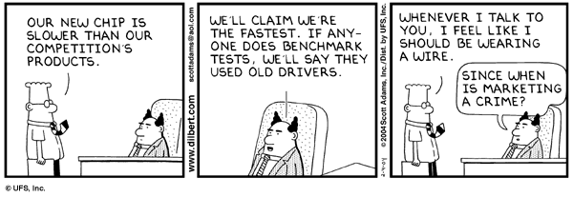
Profession
Be accurate in stating the characteristics of software on which they work, avoiding not only false claims but also claims that might reasonably be speculative, vacuous, deceptive, misleading, or doubtful.

Slide 17
Principle 6: Profession
6.01
6.02
6.03
6.04
6.05
6.06
6.07
Associate with reputable people Promote commitment of this code Support followers of this code
Help develop an ethical environment Report suspected violations of this code Take responsibility for errors
Only accept appropriate remuneration

Slide 18
Principle 6: Profession (Cont.)
6.08
6.09
6.10
6.11
6.12
6.13
Be accurate and honest regarding software Place professional interests before personal Obey all laws governing your work Exercise professional responsibility Promote public knowledge of the subject Share software knowledge with the
profession

Slide 19
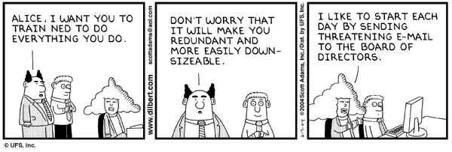
Colleagues
7.02. Assist colleagues in professional development.

Slide 20
Principle 7: Colleagues
7.01
7.02
7.03
7.04
7.05
7.06
7.08
7.09
7.10
Assist colleagues in professional development Review other’s work only with their consent Credit fully the work of others
Review others work candidly Give fair hearing to colleagues
Assist colleagues’ awareness of work practices Do not hinder a colleague’s career
Do not pursue a job offered to a colleague Seek help with work outside your competence

Slide 21
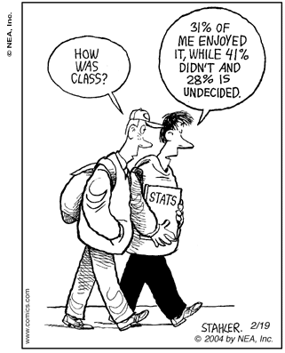
Self
Further their knowledge of developments in the analysis, specification, design, development, maintenance, and testing of software and related documents, together with the management of the development process.

Slide 22
Principle 8: Self
8.01
8.02
8.03
8.04
8.05
8.06
8.07
8.08
Further your own professional knowledge Improve your ability to produce quality work Improve your ability to document work Improve your understanding of work details Improve your knowledge of relevant legislation Improve your knowledge of this code
Do not force anyone to violate this code Consider code violations inconsistent with software engineering

Slide 23


Slide 24
Example:
The Challenger Explosion
Mission 51-L NASA
January 28, 1986

Slide 25
On the cold freezing morning of January 28, 1986.
The 10th flight of Orbiter Challenger. The 25th NASA space shuttle.
One of the most publicized launches because it was the first time that a civilian, a school teacher, was going into space.
The launch of Challenger had been delayed five times due to bad weather… and January 28 was the coldest day that NASA had ever launched a shuttle.
Seventy three seconds into flight, the Orbiter Challenger exploded, killing all seven of its crew.

Slide 26

The Explosion
CNN Online Archive

Slide 27
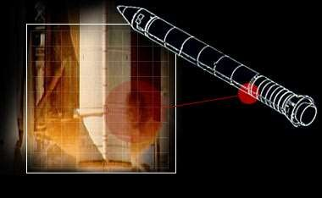
3 Seconds…
CBS News.Com Interactive Challenger Disaster

Slide 28
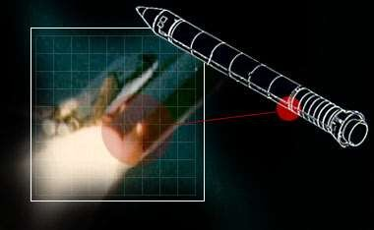
59 Seconds…
CBS News.Com Interactive Challenger Disaster

Slide 29
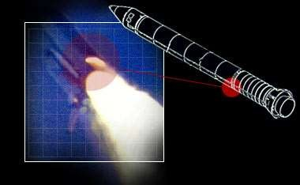
64.7 Seconds…
CBS News.Com Interactive Challenger Disaster

Slide 30
Report of the Presidential Commission on the Space Shuttle Challenger Accident
In view of the findings, the Commission concluded that the cause of the Challenger accident was the failure of the pressure seal in the aft field joint of the right Solid Rocket Booster. The failure was due to a faulty design unacceptably sensitive to a number of factors. These factors were the effects of temperature, physical dimensions, the character of materials, the effects of reusability, processing and the reaction of the joint to dynamic loading.
“The decision to launch the Challenger was flawed.”

Slide 31
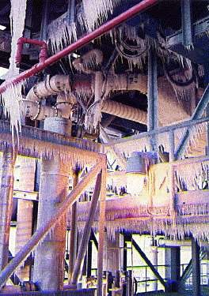
http://www.jlhs.nhusd.k12.ca.us/Classes/Social_Science/Challenger.html/C hallenger.html

Slide 32

Ariane 5 & The Patriot Missile
Notes:
https://www.youtube.com/watch?v=5tJPXYA0Nec

Slide 33
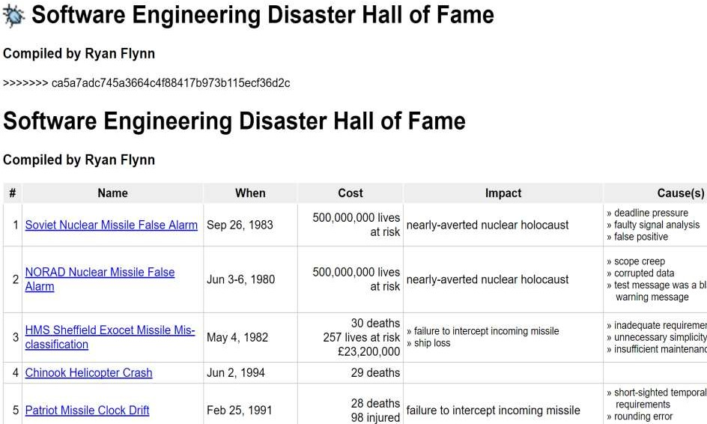
Notes:
http://www.parseerror.com/bugs

Slide 34
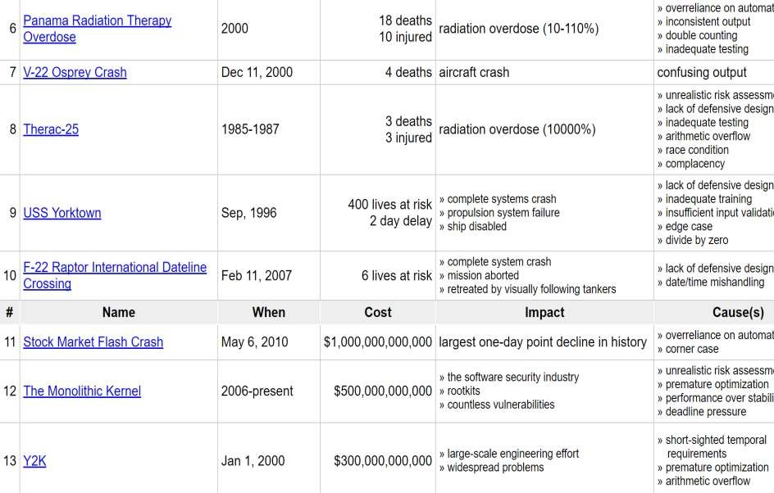

Slide 35
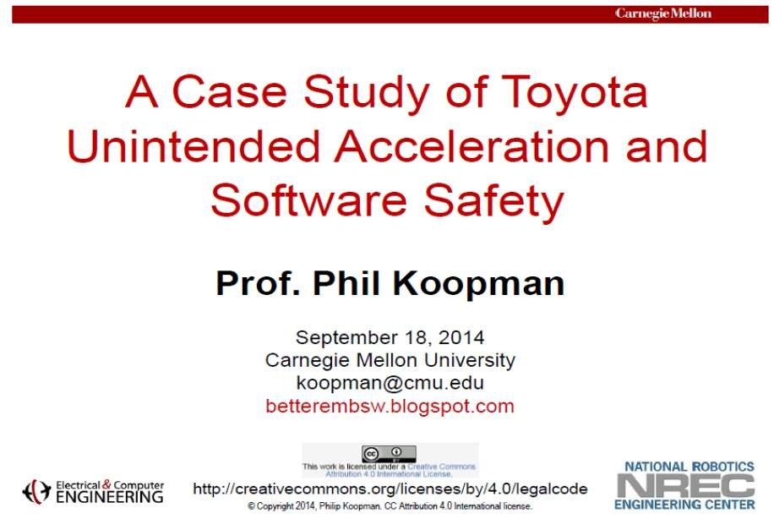
Notes:
https://users.ece.cmu.edu/~koopman/pubs/koopman14_toyota_ua_slides.pdf

Slide 36
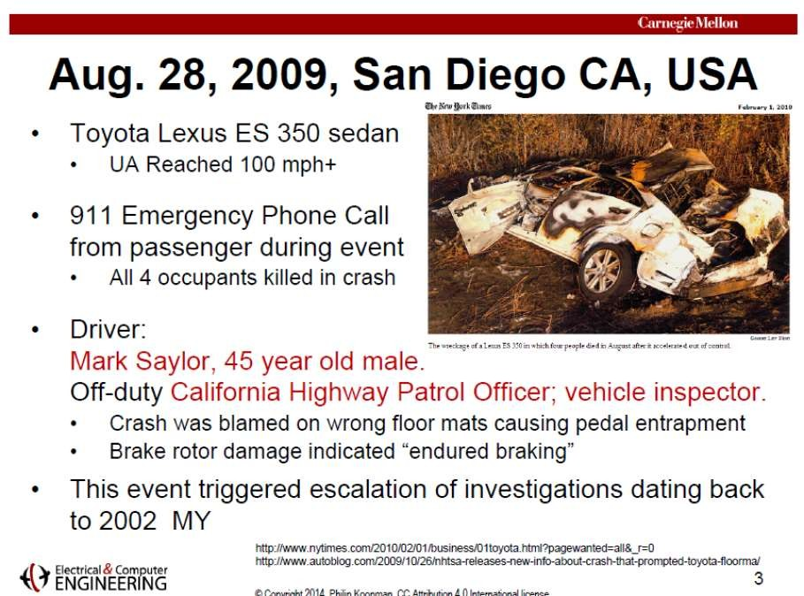

Slide 37
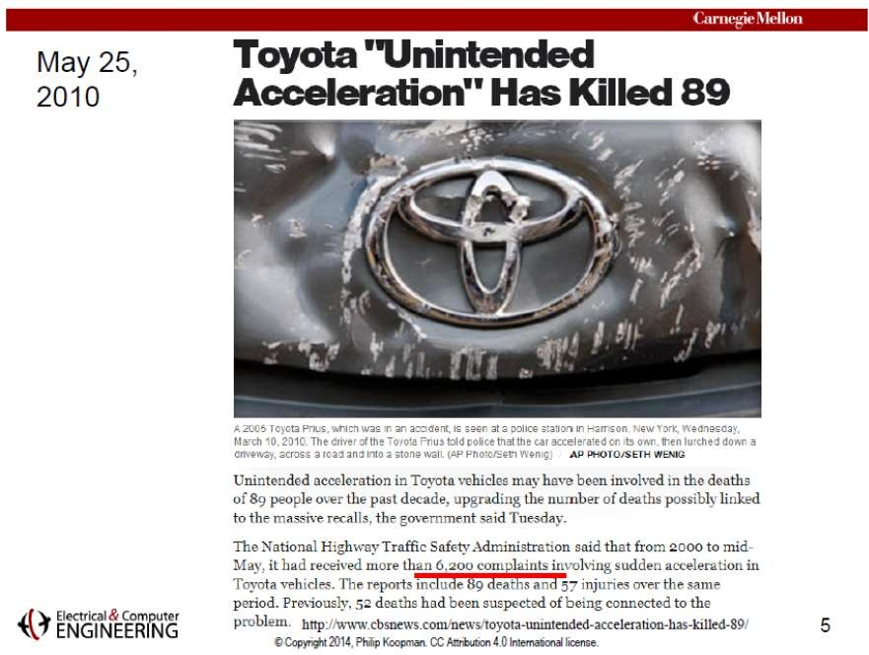

Slide 38
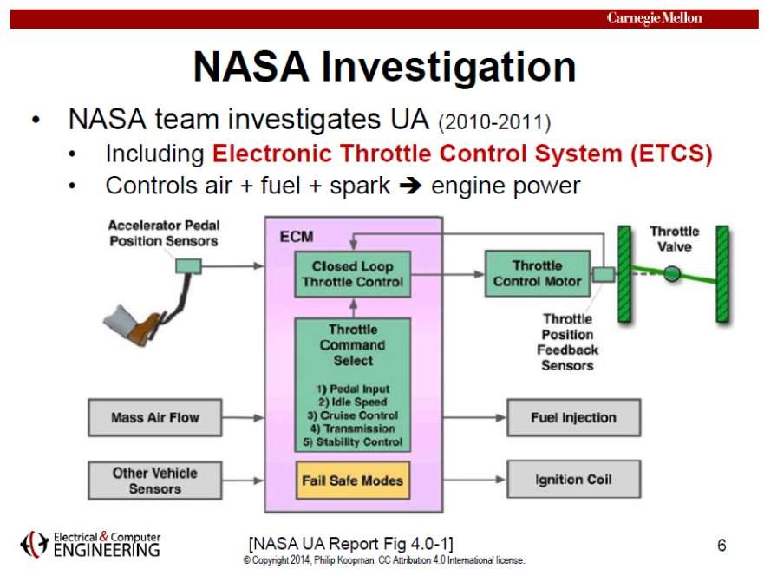

Slide 39
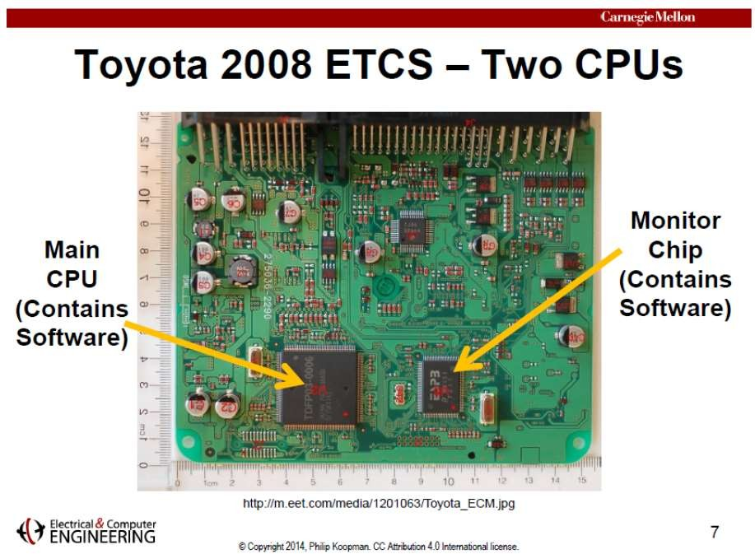

Slide 40
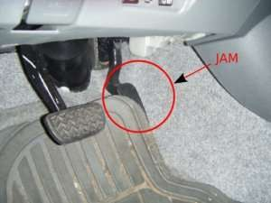
Toyota Claimed:
Gas pedal get stuck under the floor mat.
The ETCS software testing shows no possibility of
Unintended Acceleration…

Slide 41
Experts Found:
Toyota’s source code defective… Bugs that can lead to unintended acceleration.
Stack Overflow and Software Bugs led to Memory Corruption.
Testing is not enough to establish safety.
High number of Global Variables.
Code complexity that hindered testing.
Concurrency bugs / Race conditions.

Slide 42
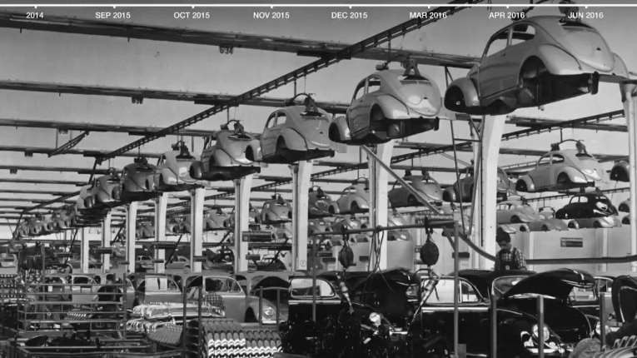
Volkswagen Emissions Cheating
Notes:
https://www.youtube.com/watch?v=Y5TvFY7xRDM

Slide 43

Target Company Data Mining

Slide 44
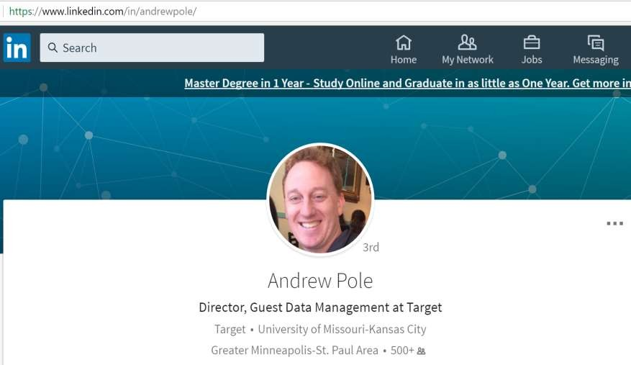
“Guest Data Management”

Slide 45
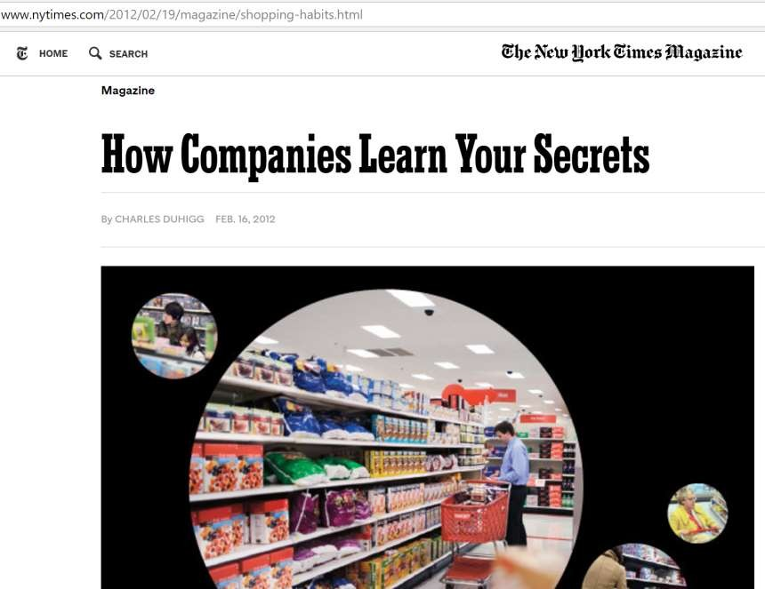

Slide 46
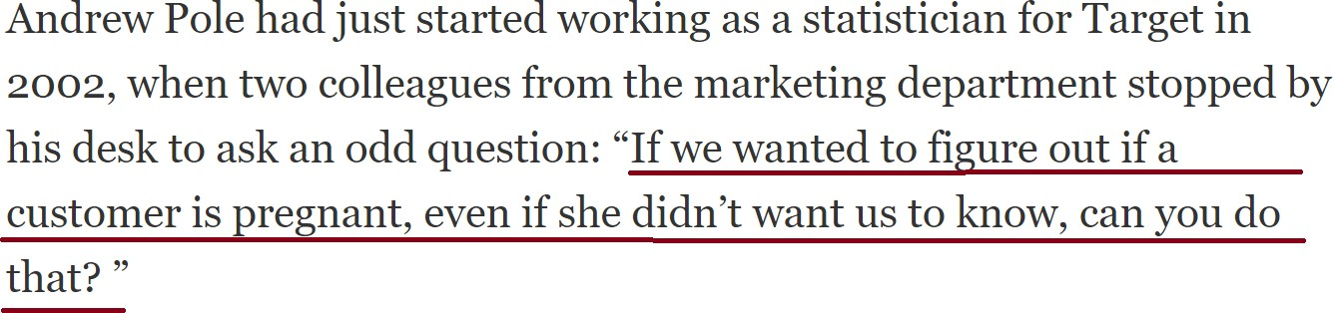
A simple request…

Slide 47
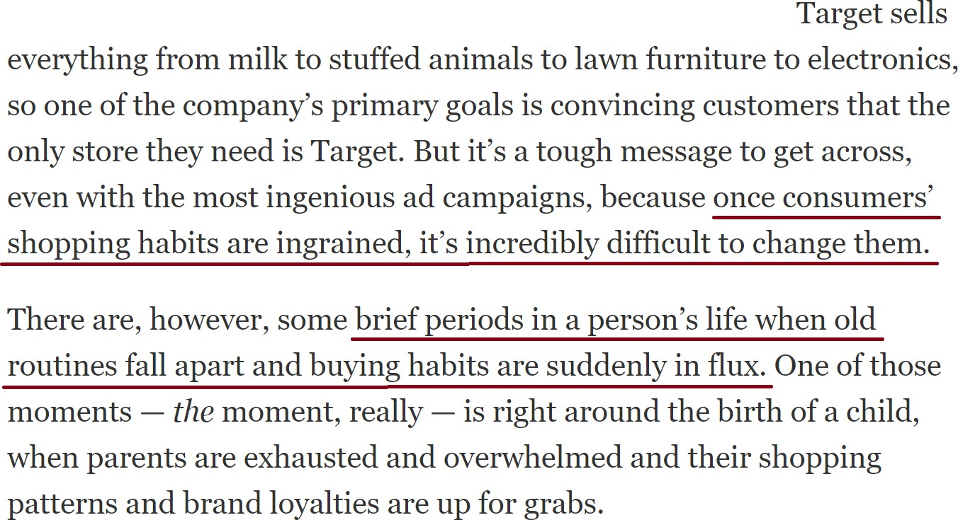
Why?

Slide 48
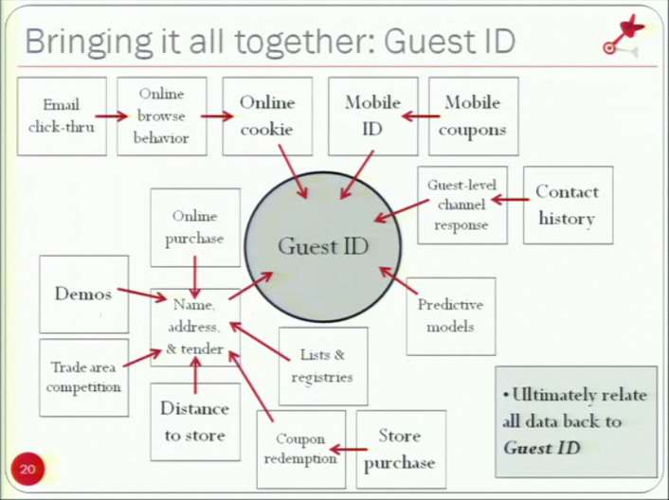
The data…

Slide 49
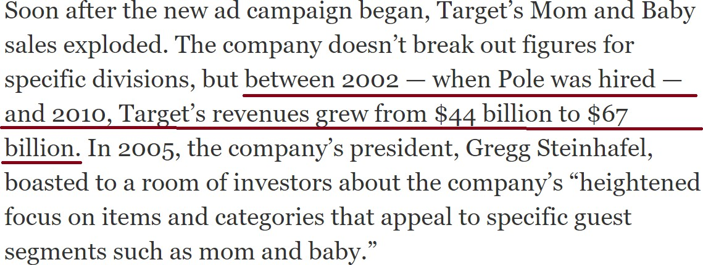
Success!

Slide 50
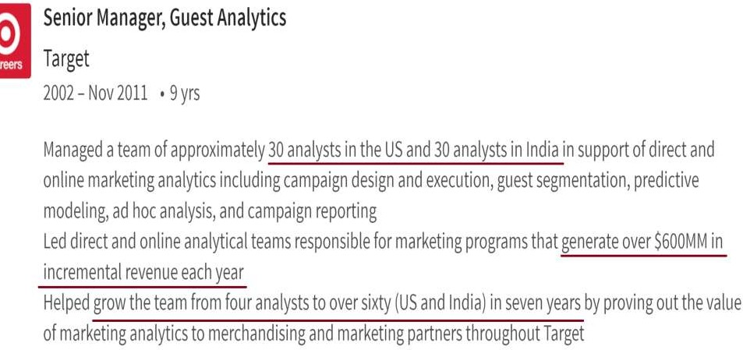
From Andrew Pole’s LinkedIn Profile

Slide 51

Too much success?!
* Not the actual customer in the story!

Slide 52
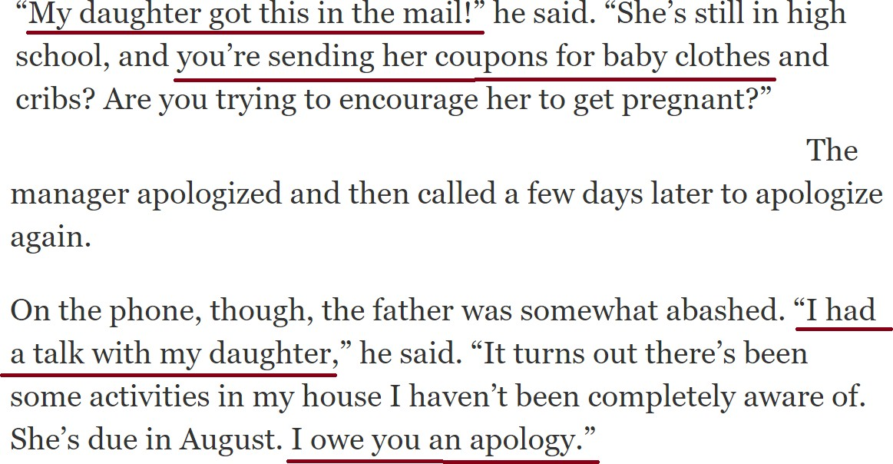
Too much success?!

Slide 53
Ethical Issues (Related to all those stories)
Putting public interest above personal or corporate gain.
Honesty.
Rigor in Software design, review, testing, documentation…
Following safety standards…
Customer privacy.
Other issues…?

Slide 54
Thank You

